Slide 1
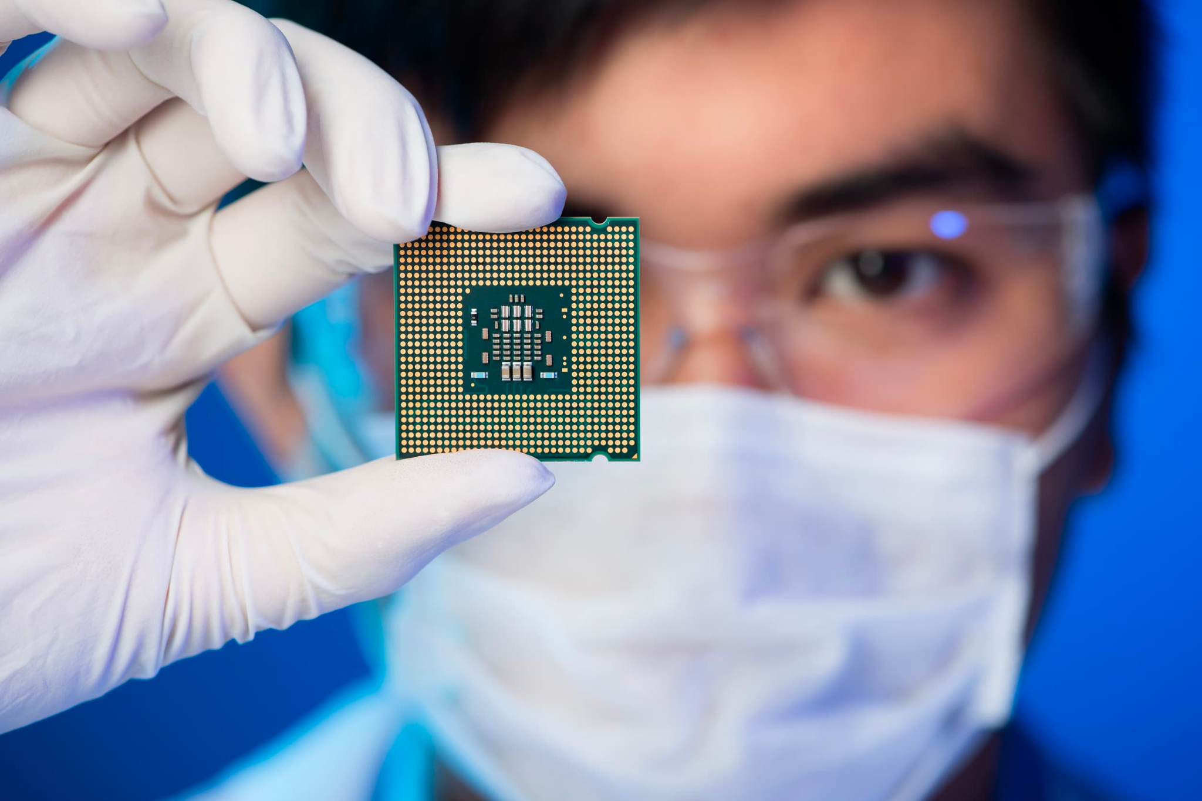
What processor is a monolith for the smartphone and tablet industry?
It’s known as the ideal processing chip for battery-powered devices.
It’s more power efficient than x86 chips, which means they can run for longer on a single battery charge
The world's most powerful supercomputer, Fugaku, is powered by this chip.
It’s popularly known as an acronym of Acorn RISC Machine

Slide 2
ARM 64-bit Processor
By Claire, Din, Mohamed, and Wisdom

Slide 3
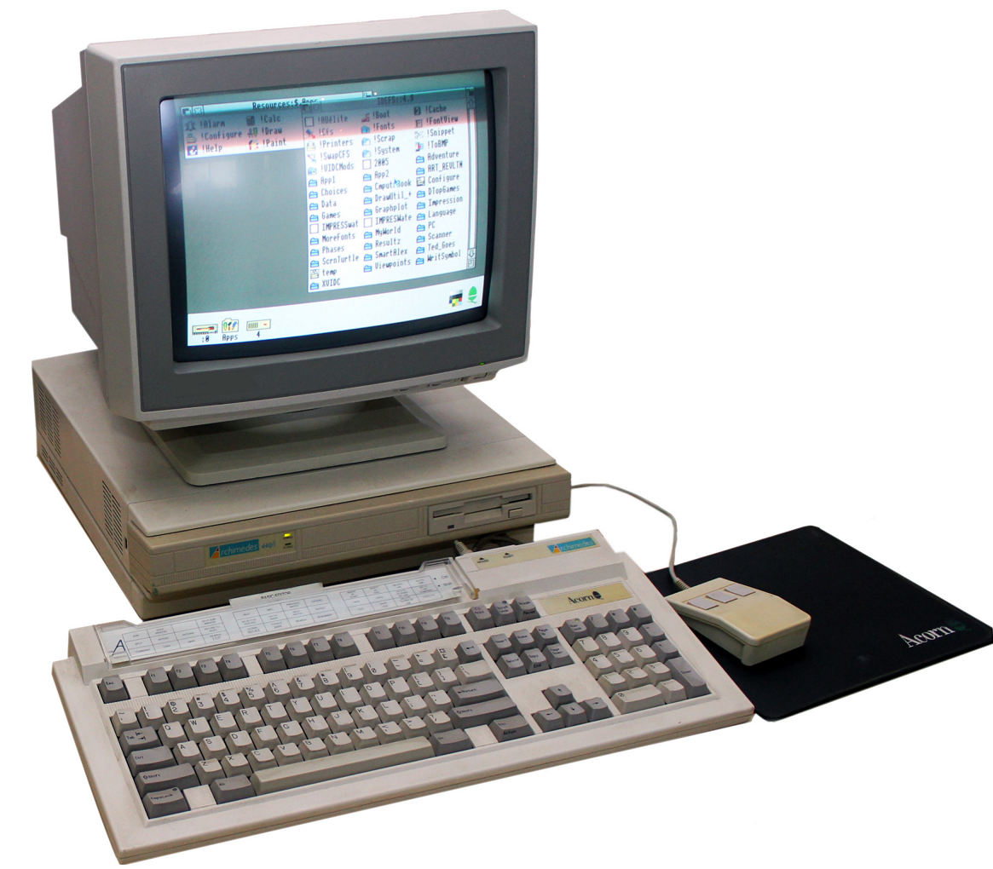
Introduction
ARM stands for Advanced RISC Machines.
ARM chips are a type of processor that is used in a wide variety of devices.
ARM chips are designed to be power efficient, which makes them ideal for mobile devices.
ARM chips are used in more than 95% of all smartphones.
The first ARM chip was released in 1985.

Slide 4

Founding of ARM
In 1980s, Acorn Computers developed the innovative 32-bit Acorn RISC Machine (ARM) processor for its Archimedes PC.
Seeing the potential of this energy-efficient RISC architecture, Acorn collaborated with Apple and chipmaker VLSI Technology to spin out a new company focused on developing and licensing the ARM processor.
In November 1990, Advanced RISC Machines Limited was incorporated as a joint venture between Acorn, Apple, and VLSI.
ARM's first CEO was Larry Tesler, a prominent Apple executive who was involved in early Newton's PDA development.
While the first few years saw low volumes and minimal profits, ARM gained ground through the 90s by licensing cores to companies making chips for mobile phones, set-top boxes, and embedded devices.
1993 marked ARM's first profitable year. By the end of the decade, ARM was being widely adopted by mobile chipmakers and had grown into a successful standalone company.
Along the way, there were several important milestones:
1994 - ARM opened offices in Silicon Valley and Tokyo
1997 - ARM took a stake in Palmchip for system-on-chip IP
1998 - Changed name to ARM and launched IPO
Today, ARM's RISC processors and architectures dominate the mobile world. With over 100 billion chips shipped, ARM truly transformed from a small joint venture into an industry leader.

Slide 5



Development of the ARMv8-A architecture
ARMv8 was first released in 2011.
ARMv8 is a 64-bit architecture, which means that it can address more memory than previous generations of ARM processors.
ARMv8 includes a new instruction set, a new memory model, and new security features.
The ARMv8-A architecture is the most widely used implementation of the ARMv8 architecture.
ARMv8-A is designed for applications processors, which are the processors that power smartphones, tablets, and other mobile devices.

Slide 6
ARMv8 - The features
Improved Performance: ARMv8 brings performance improvements by leveraging the increased register size and wider data paths enabled by 64-bit architecture. It also includes features like improved floating-point operations, enhanced SIMD (Single Instruction, Multiple Data) capabilities, and better virtualization support.
Security Enhancements: ARMv8 architecture incorporates various security features to mitigate security threats. These include hardware-enforced privilege levels, address space isolation, and improved cryptography support.
Ecosystem and Adoption: The ARMv8 architecture has gained widespread adoption across various sectors, including mobile devices, servers, and embedded systems. It has enabled the development of more powerful and efficient processors that can handle demanding workloads.
Software Support: Alongside the hardware development, the software ecosystem has evolved to support ARMv8. Operating systems, compilers, libraries, and development tools have been updated to take advantage of the 64-bit capabilities and optimize performance for ARMv8 processors.
Continued Evolution: ARM continues to refine and enhance the ARMv8 architecture with subsequent revisions and updates. These updates may introduce new features, performance improvements, and optimizations to meet the evolving needs of different application domains.
64-bit Addressing: Mentioned previously, one of the key benefits of ARMv8 is the expanded memory addressing capability. With 64-bit addressing, ARMv8 processors can access significantly larger memory spaces, enabling more complex and memory-intensive applications to run efficiently.

Slide 7
Video
ARM 64-Bit video.mp4

Slide 8
CPU Architecture Cores
Cores are the individual processing units within an ARM 64-bit Processor. They are responsible for executing instructions and performing calculations.
ARM 64-bit Processors often include multiple cores, which enables what we call parallel processing. This means that multiple tasks can be executed simultaneously, resulting in improved overall performance.
Multiple cores allow for increased performance. By distributing tasks among the cores, the processor can tackle more work in a given timeframe. This is particularly beneficial for applications that require heavy computational workloads.
Improved multitasking capabilities. With each core handling a separate task, you can smoothly run multiple applications at the same time without significant slowdowns. For instance, you can run resource-intensive applications while simultaneously browsing the internet or listening to music.
Multi-core architectures provide scalability. By adding more cores, you can scale up the processing power to meet the requirements of demanding applications like gaming and video editing.

Slide 9
Hyper-Threading
Hyper-threading is a technology that allows each core in the processor to handle multiple threads simultaneously.
In ARM 64-bit Processors, hyper-threading is implemented through a technique known as simultaneous multithreading (SMT). This technology enhances overall CPU efficiency by utilizing idle resources within each core.
Well, by allowing each core to handle multiple threads, hyper-threading enables a more efficient use of available resources. When one thread encounters a delay, such as waiting for data from memory, the core can switch to another thread and continue processing.
This approach reduces the idle time of the core, improving overall CPU utilization. In essence, hyper-threading ensures that the core stays busy by taking advantage of available resources and keeping the pipeline filled with instructions.
By maximizing core utilization, hyper-threading can lead to increased performance in multi-threaded applications. It allows for better concurrency, enabling more efficient execution of tasks and faster completion of workloads.

Slide 10
Caching
Caching is a technique used in ARM 64-bit Processors to store frequently accessed data closer to the CPU, enabling faster access compared to accessing data directly from main memory.
Caches act as intermediate storage between the CPU and main memory, helping to bridge the speed gap between the two.
In ARM 64-bit Processors, caches are organized in a hierarchy, typically consisting of three levels: L1, L2, and L3.
The L1 cache is the closest to the CPU and has the smallest capacity but the fastest access speed. It holds data and instructions that are frequently accessed by the CPU's cores.
The cache hierarchy in ARM 64-bit Processors is designed to take advantage of spatial and temporal locality, which refers to the tendency of programs to access data and instructions that are nearby in memory and frequently accessed together.
by storing frequently accessed data closer to the CPU, caching reduces memory latency and improves data retrieval speed.
The cache hierarchies performance benefits are significant. It minimizes the need for accessing main memory, which is comparatively slower, and reduces the overall latency of memory operations.

Slide 11
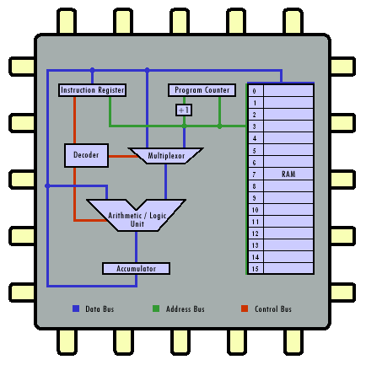
Registers
Registers are small, high-speed memory locations within the CPU that play a crucial role in the execution of instructions.
In ARM 64-bit Processors, there are two main types of registers: general-purpose registers (GPRs) and special-purpose registers (SPRs).
GPRs are used for storing data during program execution. They are versatile registers that can hold operands, intermediate results, and memory addresses.
On the other hand, SPRs are designed for specific tasks, such as storing program status and control information. These registers help manage exceptions, interrupts, and system-level operations.

Slide 12
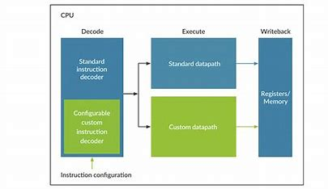
Sample Instructions
Sample instructions are the basic operations that the processor can perform, ranging from arithmetic and logic operations to data transfer and control flow instructions.
Arithmetic and logic instructions include operations like addition, subtraction, and bitwise operations. These instructions manipulate data within registers.
Data transfer instructions enable the movement of data between registers and memory locations, allowing for efficient data manipulation and storage.
Control flow instructions alter the program's execution path, facilitating branching and looping operations. They determine the flow of instructions based on conditions or loops in the code.

Slide 13
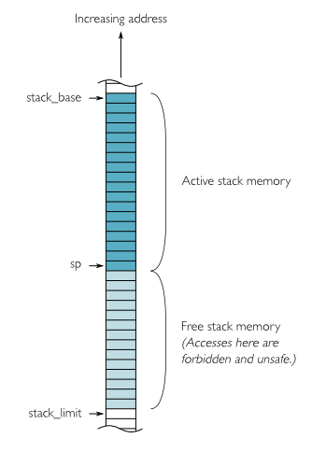
Stack Management
Stack management involves the management of the stack memory region, which is essential for supporting function calls and local variable storage.
Two key registers involved in stack management are the stack pointer (SP) and frame pointer (FP). The stack pointer keeps track of the top of the stack, while the frame pointer helps with accessing and manipulating specific stack frames.
Pushing and popping data onto the stack are fundamental operations in stack management. Pushing places data onto the stack, while popping retrieves and removes data from the stack.
Stack management is critical for maintaining program flow and managing data within function calls, making it an essential aspect of the ARM 64-bit Instruction Set Architecture.

Slide 14
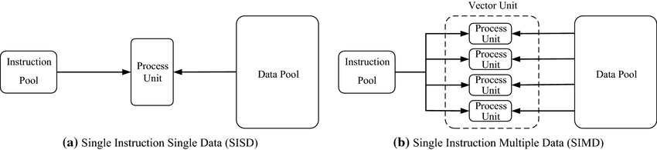
SIMD Instructions
SIMD instructions enable parallel processing of multiple data elements simultaneously, allowing for faster and more efficient computation.
These instructions operate on data packed into vectors or arrays, performing the same operation on multiple data elements in parallel.
SIMD instructions are particularly valuable in multimedia and data-intensive applications where simultaneous processing of data is crucial for performance gains.

Slide 15
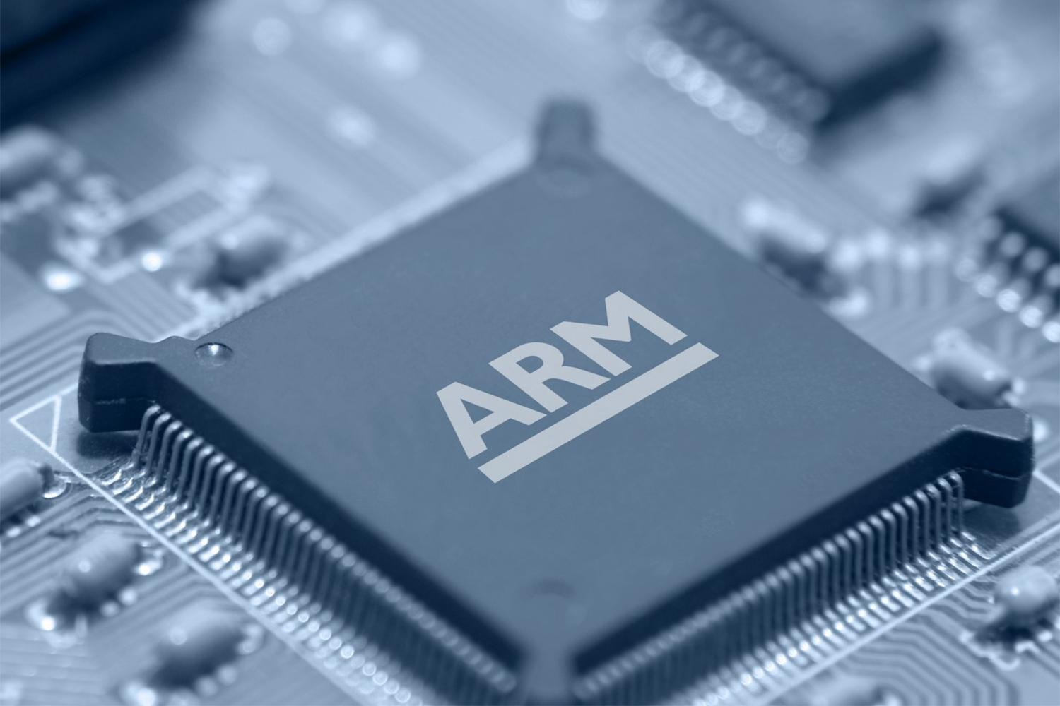

Memory Management
Introduction to Memory Management
How Paging Works
The Role of Virtual Memory
Memory Management Unit (MMU) in ARMv8-A and it’s Key Benefits
Page Faults
Translation Lookaside Buffer (TLB)
Notes:
I am excited to discuss one of the fundamental aspects of computer architecture that plays a crucial role in the
efficiency and security of modern computing systems: Memory Management, and specifically how ARM, a
powerful processor architecture, utilizes various features for efficient memory management.
ARM's memory management innovations remain pivotal in providing us with powerful, secure, and reliable computing experiences.
To go more into detail let's discuss, Memory Management, How Paging Works, The Role of Virtual Memory,
Memory Management Unit (MMU), Page Faults, and Translation Lookaside Buffer (TLB).

Slide 16
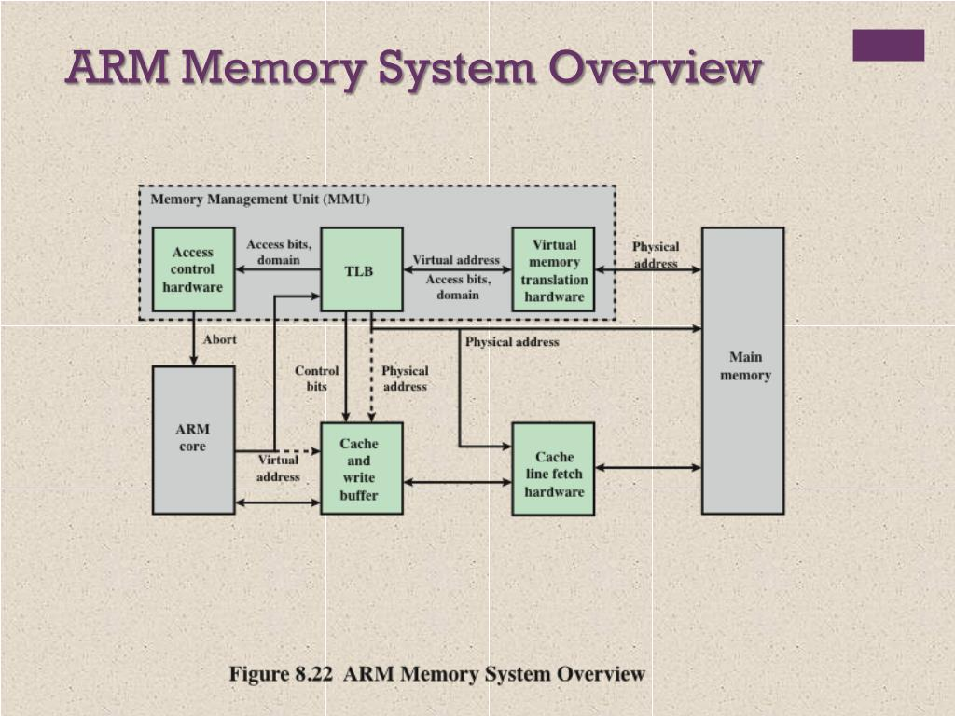
What is Memory Management?
Memory management involves three main tasks:
Allocation
Utilization
Protection.
Memory management controls access to the system's memory.
Involves dynamically allocating memory regions to different applications.
It is performed by the hardware whenever memory is accessed by the operating system or applications.
Notes:
Memory management describes how access to memory in a system is controlled.
The hardware performs memory management every time that memory is accessed by either the OS or applications.
Memory management is a way of dynamically allocating regions of memory to applications.
Memory management involves managing the allocation, utilization, and protection of computer memory.

Slide 17
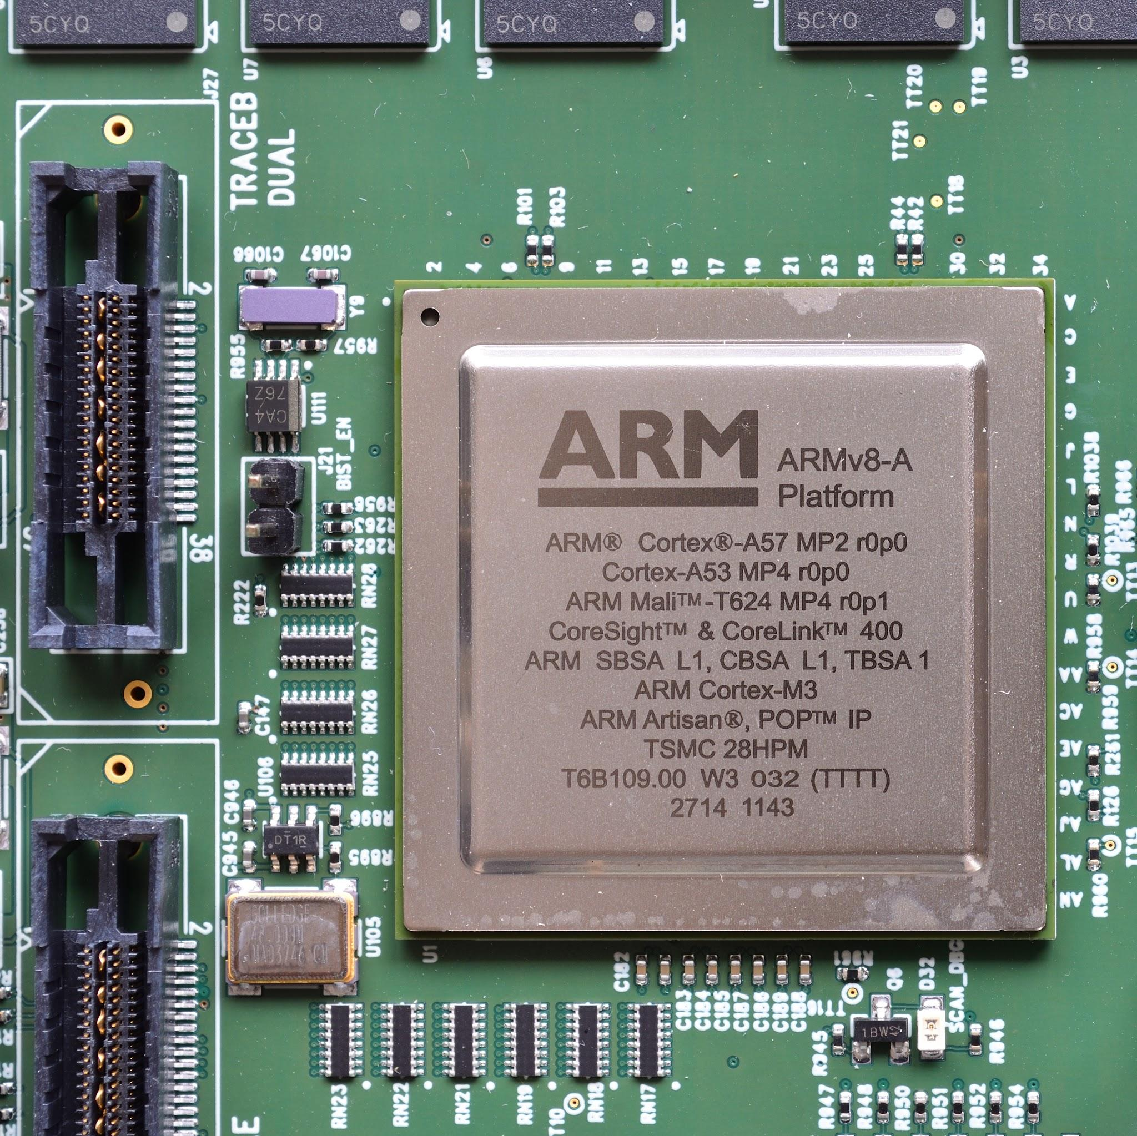
Became the foundation for modern ARM-64 CPU memory management.
This allows ARM processors to address up to 16 exabytes of memory.
ARMv8-A supports a virtual memory system, allowing processes to utilize more memory than physically available.
The improvements to memory management in ARMv8-A are a major step forward for the ARM architecture
ARMv8-A introduced the 64-bit instruction set and brought significant improvements to memory management.
Notes:
What makes ARMv8-A special is that it introduced the 64-bit instruction set and brought significant improvements to
memory management. It's the foundation for ARM-64 CPU memory management, and it introduced a number of new features
for memory management, including virtual memory, MMUs, and page tables.
ARMv8-A makes it possible for computers to use more memory than they physically have. To quickly preface how,
it does so by creating virtual addresses for each process, and then translating those virtual addresses to physical
addresses when the process needs to access memory.

Slide 18
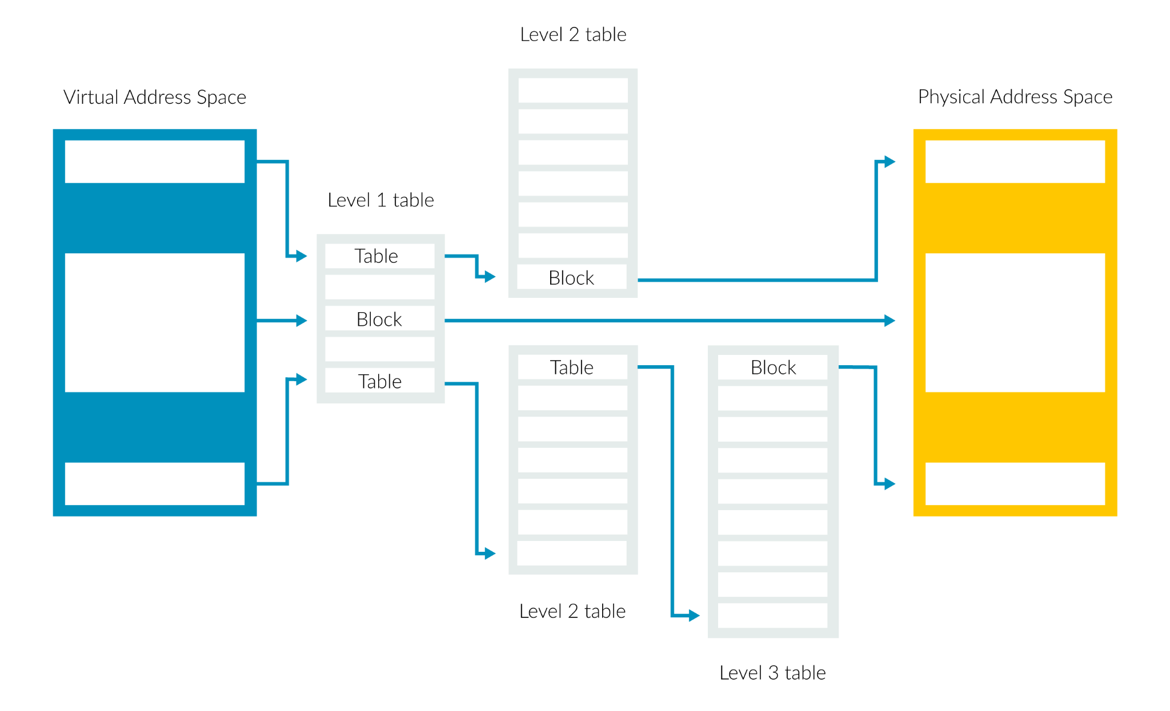
Paging
Pages are typically small in size, commonly 4 KB or 8 KB.
A virtual address is split into two parts: the page number and the page offset.
The page number is used as an index into the page table to retrieve the corresponding page table entry.
The page offset determines the specific location within the page that the virtual address points to.
Memory protection is enforced by the CPU through the use of access control mechanisms, preventing unauthorized access, ensuring data integrity, and enabling secure execution of processes.
Notes:
Paging is a memory management technique that divides memory into fixed-size blocks called pages. Pages are
typically small in size, commonly 4 KB or 8 KB. Paging allows for efficient memory allocation and management
by dividing physical memory into equal-sized chunks. Each page is assigned a unique page table entry in the
page table, which is a data structure used by the CPU to manage virtual memory. The page table entry contains
information about the corresponding page, such as its physical address and access permissions.
When a program references a virtual address, the CPU translates it to a physical address using the page table.
The CPU performs this translation by looking up the virtual address in the page table and retrieving the corresponding
page table entry.
The translation process involves splitting the virtual address into different parts, such as the page number
and page offset. The page number is used as an index into the page table to retrieve the corresponding page table entry.
The page offset determines the specific location within the page that the virtual address points to.
The page table's are essential components of the memory management system in ARMv8-A. They allow for
efficient memory management by providing a way to translate virtual addresses to physical addresses quickly
and easily.
Memory protection ensures that processes cannot access memory regions that they are not supposed to access. Memory
protection is enforced by the CPU through the use of access control mechanisms, such as page table entries. So when a
process attempts to access memory, the CPU checks the corresponding page table entry to determine if the access is allowed.
Memory protection is crucial for preventing unauthorized access, ensuring data integrity, and enabling secure execution of processes.
The CPU's memory management hardware and the operating system work together to enforce memory protection mechanisms.
Operating systems use various techniques, such as memory segmentation and paging, to manage memory and provide memory protection.

Slide 19
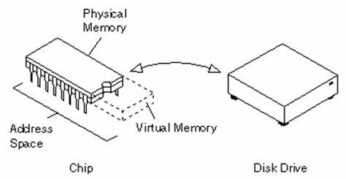
Virtual Memory
Physical addresses: represents the actual locations in the physical memory where data is stored
Virtual addresses: Used by processes and programs and are translated into physical addresses by the memory management unit (MMU).
Address translation: is the process of converting virtual addresses to physical addresses.
Memory protection: ensures that processes cannot access memory regions that they are not supposed to access.
Notes:
Physical addresses represent the actual locations in physical memory where data is stored.
Virtual addresses are used by processes and programs and are translated into physical addresses by the memory
management unit (MMU).
The Memory Management Unit is a hardware unit in the CPU that performs address translation. In short,
when a process accesses a virtual address, the MMU job is to look up the corresponding page table entry in the
page table. The page table entry contains the physical address of the memory page that the virtual address refers to.
Virtual addresses are used by processes and programs and are translated into physical addresses by the memory management
unit (MMU).
Address translation is the process of converting virtual addresses to physical addresses. The MMU performs the
address translation using data structures called page tables or translation tables.
Memory protection ensures that processes cannot access memory regions that they are not supposed to access.
Memory protection is enforced by the CPU through the use of access control mechanisms, such as page table entries.
Memory management is a complex topic, but it is essential for the efficient and secure operation of computer systems.

Slide 20
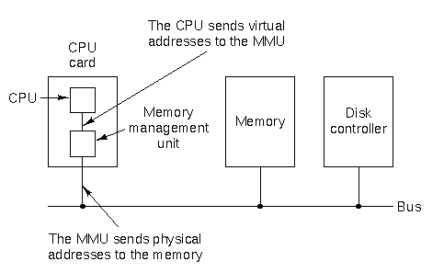
Memory Management Unit
The Memory Management Unit performs the address translation using page tables or translation tables.
These tables map virtual addresses to physical addresses, and they also contain information about memory permissions and cache policies.
When the processor accesses memory, it first looks up the virtual address in the translation tables.
If the address is found, the MMU returns the corresponding physical address.
If an address is not found by the MMU, a page fault occurs.
Notes:
The MMU is a hardware unit that translates virtual addresses to physical addresses. This allows
the processor to access memory that is not directly mapped to physical addresses. The MMU also
provides features such as memory protection and cache management.
How the MMU works
The MMU is implemented as a set of translation tables. These tables map virtual addresses to physical
addresses, and they also contain information about memory permissions and cache policies. When the
processor accesses memory, it first looks up the virtual address in the translation tables. If the address is
found, the MMU returns the corresponding physical address. Otherwise, the access is denied.
Benefits of the MMU
The MMU provides a number of benefits, including:
1.) Improved performance: The MMU can improve performance by caching translations of frequently
accessed memory addresses.
2.) Improved security: The MMU can improve security by preventing unauthorized access to memory.
3.) Increased flexibility: The MMU can increase flexibility by allowing the system to be configured with
different memory mappings.
The MMU is a key component of the memory management system in ARM architecture. It provides a
number of features that allow the processor to access memory efficiently and securely. The MMU is a
complex unit, but it is essential for the efficient operation of ARM-based systems.

Slide 21
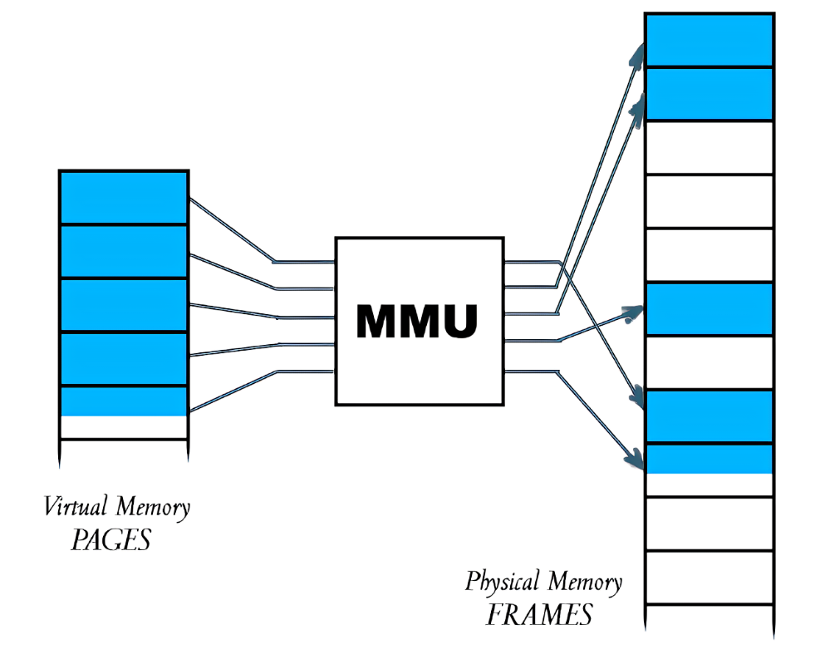
Other Key Benefits of MMU
The MMU improves performance by caching translations of frequently accessed memory addresses.
The MMU improves security by preventing unauthorized access to memory.
The MMU increases flexibility by allowing the system to be configured with different memory mappings, which can improve security and reliability.
Notes:
The MMU is a hardware unit that translates virtual addresses to physical addresses. This allows
the processor to access memory that is not directly mapped to physical addresses. The MMU also
provides features such as memory protection and cache management.
How the MMU works
The MMU is implemented as a set of translation tables. These tables map virtual addresses to physical
addresses, and they also contain information about memory permissions and cache policies. When the
processor accesses memory, it first looks up the virtual address in the translation tables. If the address is
found, the MMU returns the corresponding physical address. Otherwise, the access is denied.
Benefits of the MMU
The MMU provides a number of benefits, including:
1.) Improved performance: The MMU can improve performance by caching translations of frequently
accessed memory addresses.
2.) Improved security: The MMU can improve security by preventing unauthorized access to memory.
3.) Increased flexibility: The MMU can increase flexibility by allowing the system to be configured with
different memory mappings.
The MMU is a key component of the memory management system in ARM architecture. It provides a
number of features that allow the processor to access memory efficiently and securely. The MMU is a
complex unit, but it is essential for the efficient operation of ARM-based systems.

Slide 22
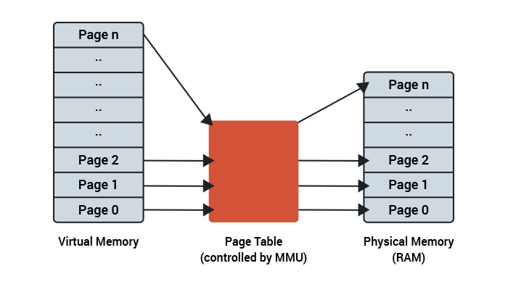
Page Faults
A page fault is an exception that occurs when the processor tries to access a memory address that is not mapped in the translation tables.
Types of page faults:
Hard page faults: The page is not in memory at all.
Soft page faults: The page is in memory, but it is not currently mapped to the processor's address space.
Causes of page faults:
The page is not mapped to the processor's address space.
The page is not in memory.
The page is corrupt.
The page is locked.
Handling page faults:
The operating system will handle the page fault by either loading the page into memory or by generating an error
TLB can prevent unauthorized access to memory locations that should not be accessible
Notes:
A page fault is an exception that occurs when the processor tries to access a memory address that is not mapped
in the translation tables. The translation tables are a critical part of the memory management system in ARM, and
they map virtual addresses to physical addresses. When a page fault occurs, the processor will stop executing the
current instruction and will transfer control to the operating system. The operating system will then handle the page
fault by either loading the page into memory or by generating an error.
Types of Page Faults
There are two types of page faults in ARM: hard page faults and soft page faults. A hard page fault occurs when the
page is not in memory at all. In this case, the operating system will have to load the page into memory from disk. A
soft page fault occurs when the page is in memory, but it is not currently mapped to the processor's address space.
In this case, the operating system will simply remap the page to the processor's address space.
Causes of Page Faults
There are a number of reasons why a page fault might occur in ARM. Some of the most common causes include:
1. The page is not currently mapped to the processor's address space.
2. The page is not in memory.
3. The page is corrupt.
4. The page is locked.
Handling Page Faults
The operating system will handle the page fault by either loading the page into memory or by generating an error.
If the operating system decides to load the page into memory, it will first need to find the page on disk. Once the
page has been found, the operating system will copy it into memory and then remap the page to the processor's
address space. If the operating system decides to generate an error, the processor will stop executing the current
instruction and will generate an exception.
Performance Implications of Page Faults
Page faults can have a negative impact on performance, as they can cause the processor to stop executing instructions.
This is because the processor will have to wait for the operating system to handle the page fault before it can continue
executing. The performance impact of page faults will depend on a number of factors, including the frequency of page
faults, the size of the pages, and the speed of the memory system.
Conclusion
Page faults are an important part of the MMU because they allow the operating system to manage memory efficiently.
By handling page faults, the operating system can ensure that the processor always has access to the memory it needs,
while also minimizing the impact of page faults on performance.

Slide 23
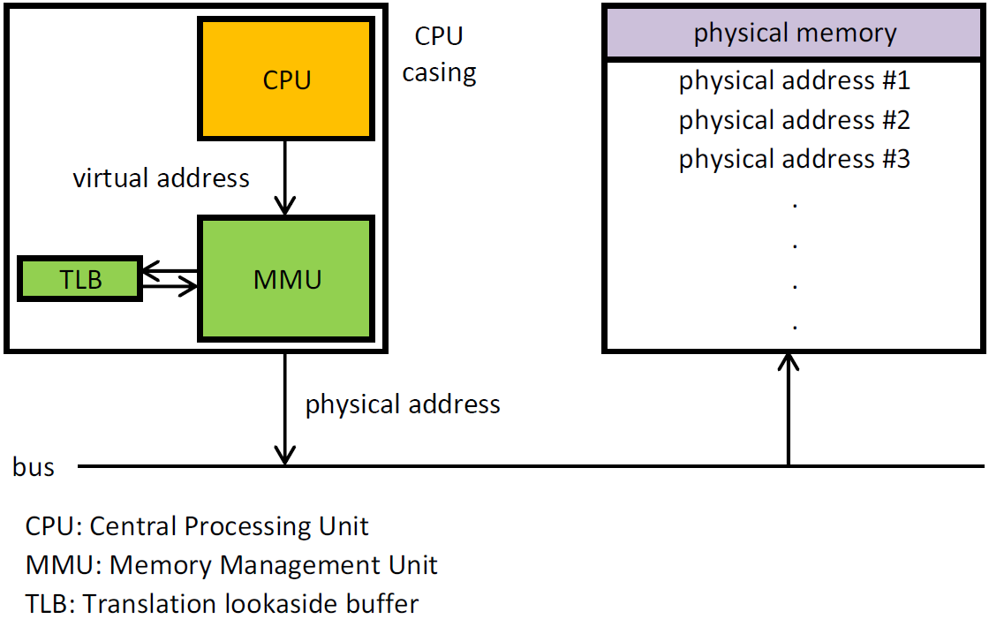
Translation Lookaside Buffer
TLB is a cache that stores recently used virtual-to-physical address translations.
CPU first checks the TLB for the corresponding translation.
If the translation is found in the TLB, it is used directly, avoiding the need to access the page table.
If the translation is not found in the TLB, the CPU performs a lookup in the page table and updates the TLB for future references.
Notes:
To boost the translation process and ensure faster memory access, CPUs utilize a hardware cache
known as the Translation Lookaside Buffer or TLB. Within the memory management and virtual
memory systems of ARM processors, the TLB plays a crucial role, significantly enhancing overall
system efficiency.
Its primary function revolves around storing recently used virtual-to-physical address translations,
thus optimizing memory access. Whenever the CPU encounters a virtual memory address, it promptly
checks the TLB for the corresponding translation. This smart cache operates as a high-speed memory cache,
capable of holding a subset of essential page table entries. By doing so, the processor cleverly avoids the
need to access the main memory page table, a process that can be slower and consume more power.
When the CPU finds the required translation in the TLB, it directly utilizes it, eliminating the need for additional
memory lookups. This process is often referred to as a "TLB hit," and it dramatically reduces access latency, thus
enhancing overall system responsiveness.
In the instances where the TLB doesn't contain the desired translation, the CPU performs a "TLB miss."
In this situation, it retrieves the translation from the main memory and promptly updates the TLB. This approach
ensures that future references to the same virtual address will be expedited, further optimizing memory access
for subsequent operations.
In conclusion Its primary function is to store recently used virtual-to-physical address translations,
making memory access faster and more efficient. This allows the processor to avoid accessing the
main memory page table, which can be slower and consume more power.

Slide 24
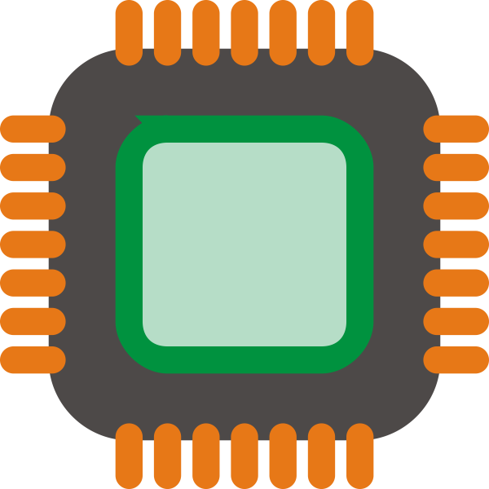

ARM - ARM doesn’t make chips but is everywhere
ARM architecture is licensed as intellectual property to partner organizations who build ARM based chips
Over 250 billion chips built with ARM architecture have been manufactured and shipped since 1990
This model means that ARM architecture is the most implemented architecture in the world
Claire

Slide 25

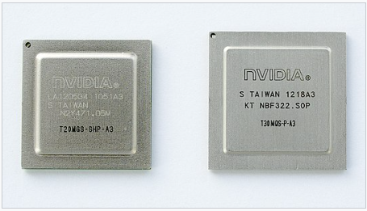
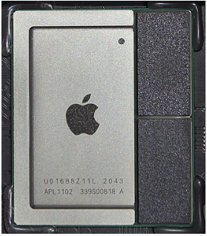
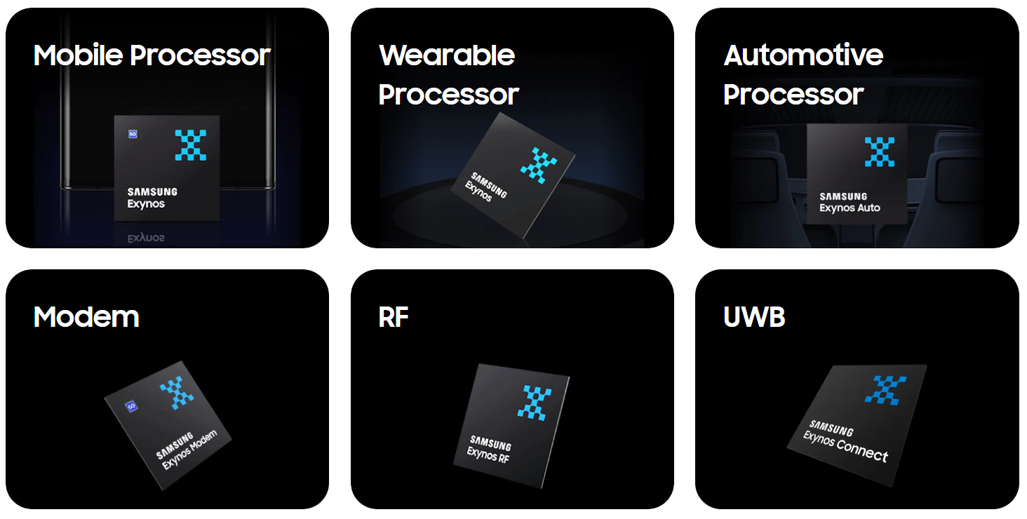


Hardware Vendors
ARM's licensing model enables a wide range of semiconductor companies to create their own ARM-based chips, leading to a diverse ecosystem of processors tailored for various applications.
Qualcomm: Snapdragon processors used in many mobile devices.
NVIDIA: Tegra series used in mobile devices and embedded systems.
Apple: Apple Silicon M1 chip used in Mac computers.
Samsung: Exynos processors for mobile devices and other consumer electronics.
NXP Semiconductors: ARM-based processors for automotive, industrial, and IoT applications.
Claire

Slide 26

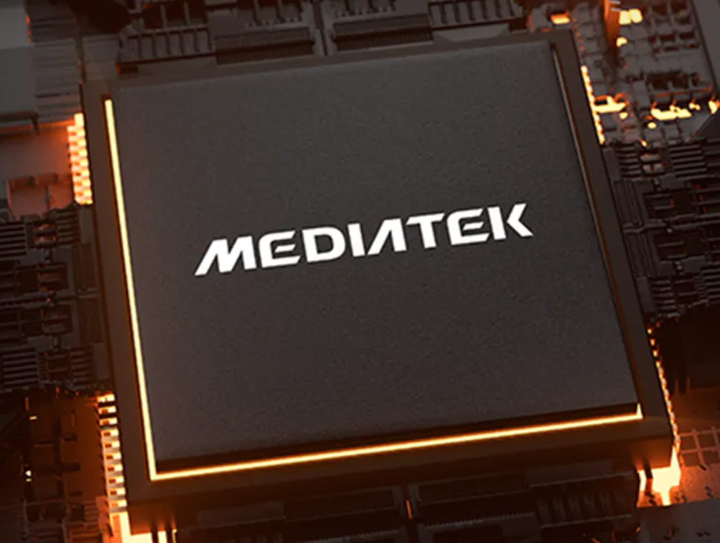




Hardware Vendors (continued)
MediaTek: Specialize in system-on-chip (SoC) , including smartphones, tablets, and smart home devices.
HiSilicon: Subsidiary of Huawei designs application processors, modem chips, and other semiconductor products. Primarily used in Huawei's smartphones and networking equipment.
Broadcom: Designs and manufactures chips for wireless connectivity, networking and storage.
Texas Instruments: Designs microcontrollers (MCUs) and application processors. TI's chips are used in industrial automation and consumer electronics.
Marvell Technology Group: Designs chips for networking, storage, and connectivity. Their products include Wi-Fi and Bluetooth chips.
Claire

Slide 27
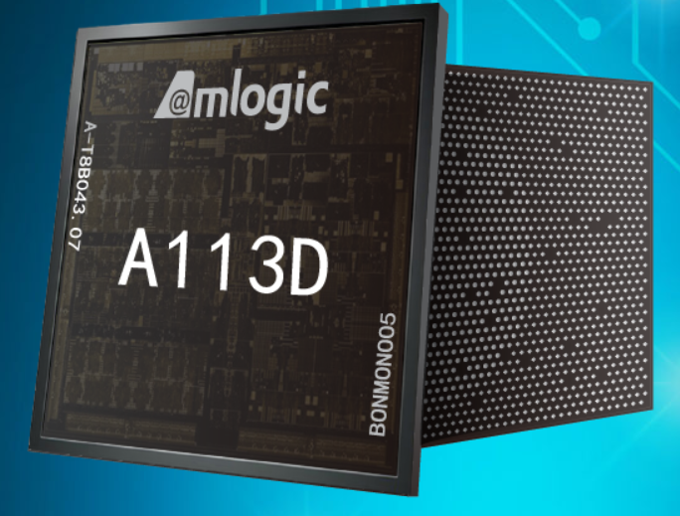



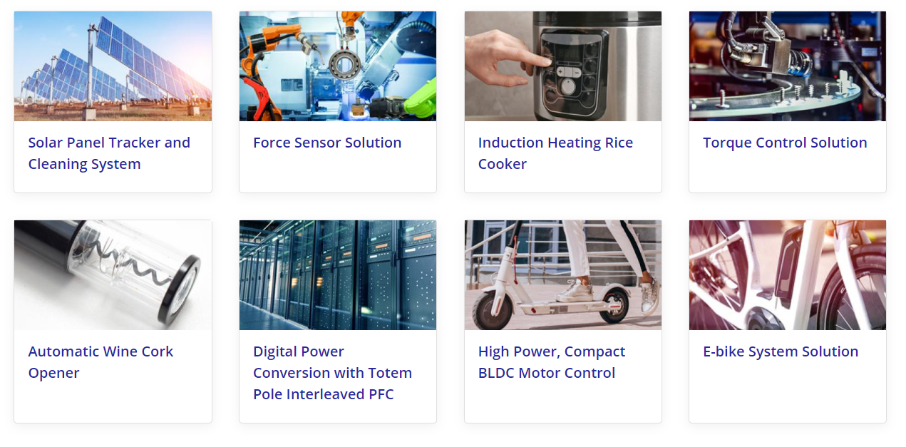
Hardware Vendors (continued)
Renesas Electronics: Automotive systems, including advanced driver-assistance systems (ADAS), infotainment, and powertrain control.
Fujitsu: Microcontrollers, ASICs (application-specific integrated circuits), and SoC for automotive, IoT, and telecommunications industry. Fugaku Supercomputer
Amlogic: SoCs for smart TVs, media players, and other multimedia devices.
Actions Semiconductor: SoCs designed for portable multimedia and consumer electronic devices specifically portable media players, e-books, and virtual reality devices
Claire

Slide 28
CPU Architecture Profiles
Implementations
Use Cases
1
Cortex-A
Neoverse
Cortex X
Computing Applications
Laptops/Tablets/PCs
Smartphones
Smart TVs
Cloud Storage
Networking Equipment
Supercomputers
2
Cortex-R
Real Time Applications
Automotive Applications (steering/Braking etc)
Medical Equipment
Cameras
Other ML Apps require real-time response
3
Cortex-M
Small Devices (Low Power/High Energy Efficiency
Internet of Things (IoT) / Embedded Devices
Sensors
Wearables
Smart Home products
Claire

Slide 29
Benefits of ARM
Simple
Fast
RISC Architecture means fewer instructions. ARM scales out rather than up
ARM Processors can execute many more instructions instructions than Intel Processors
Energy Efficient
Expanding Implementations
Reduction in energy marm processors produce less heat
Because arm is so efficient it is starting to be implemented for cloud computing and machine learning
Claire

Slide 30
ARM Noteworthy Implementations
Google:
Google's mobile operating system, Android, runs on ARM-based processors used in smartphones, tablets and Chromebooks also run on arm processors.
ARM-based server processor Tao T2A (2023)
Microsoft:
Developed the Microsoft SQ1 and SQ2 processors in collaboration with Qualcomm, powering Microsoft Surface devices.
Microsoft's Azure cloud platform offers ARM-based cloud computing resources.
Windows/VS Code and other apps now run on arm devices.
Amazon:
Amazon's Echo devices, Kindle e-readers
Amazon Web Services (AWS) instances leverage ARM-based processors (Gravitron) for specific use cases.
Claire

Slide 31
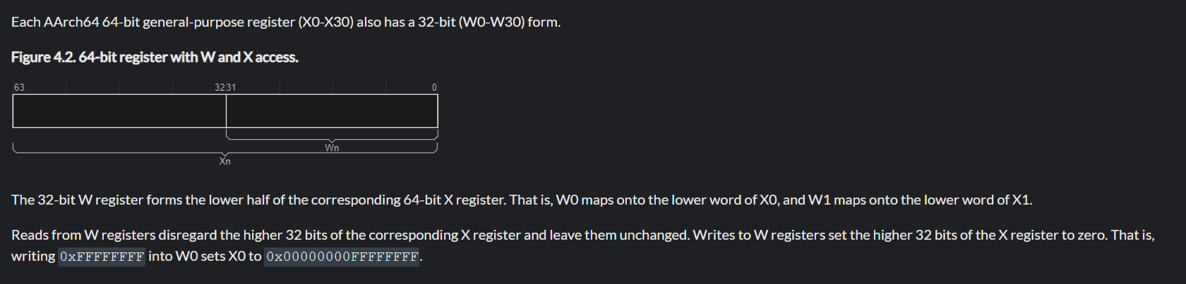
ARM Registers Used
Status Registers:
Floating-Point Registers:
Vector Registers
Special Registers
1. General-purpose registers (GPRs):
31: x0 - x30 (w0 - w30 in 32-bit mode)
Register x30 (w30 32-bit mode) is typically used as the link register for function calls
2. Stack Pointer (SP): points to the top of the current stack frame
3. Program Counter (PC) Register: holds the address of the currently executing instruction

Slide 32
Load and Store Instructions:
LDR: Loads a value from memory into a register.
STR: Stores a value from a register into memory.
LDRB: Loads a byte from memory into a register.
STRB: Stores a byte from a register into memory.
LDRH: Loads a half-word (16 bits) from memory into a register.
STRH: Stores a half-word from a register into memory.
Control Flow Instructions:
BL: Branch with link; performs a subroutine call and stores the return address in the link register (LR).
BX: Branch and exchange; branches to a specified register and changes the instruction set if necessary.
MOV: Moves a value from one register to another.
CMP: Compares two values and updates the condition flags based on the result.
Data Processing Instructions:
ADD: Adds two values and stores the result.
SUB: Subtracts one value from another and stores the result.
AND: Performs a bitwise AND operation between two values and stores the result.
ORR: Performs a bitwise OR operation between two values and stores the result.
EOR: Performs a bitwise exclusive OR operation between two values and stores the result.
CMP: Compares two values and updates the condition flags based on the result.
Data Processing Instructions:
LSL: Logical shift left performs multiplication by powers of 2
LSR: Logical shift right performs division by powers of 2
ASR: Arithmetic Shift Right LSR but preserves sign bit
ROR: Bitwise rotation
Branch Instructions
Coprocessor Instructions:
System Instructions:
SIMD Instructions:
Claire

Slide 33
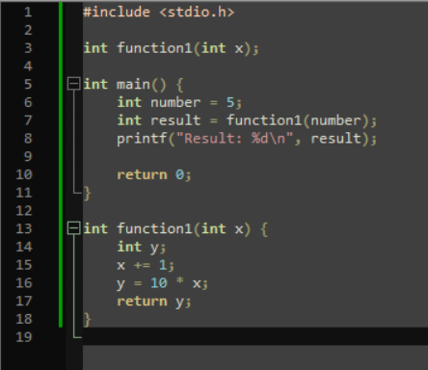
Sample C Program

Slide 34
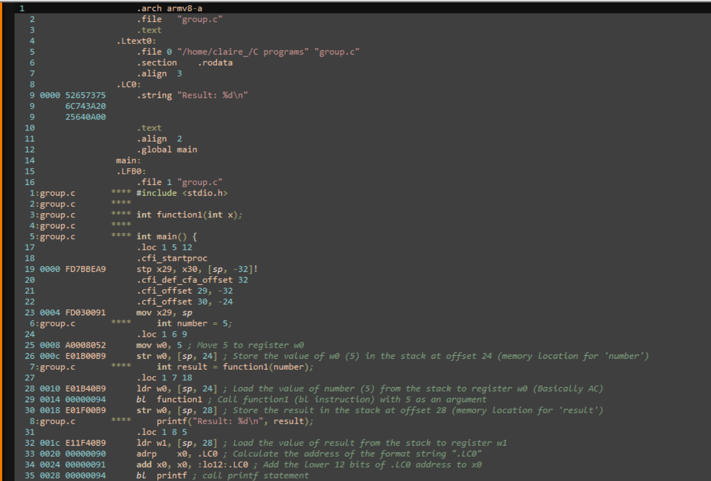
Unoptimized

Slide 35
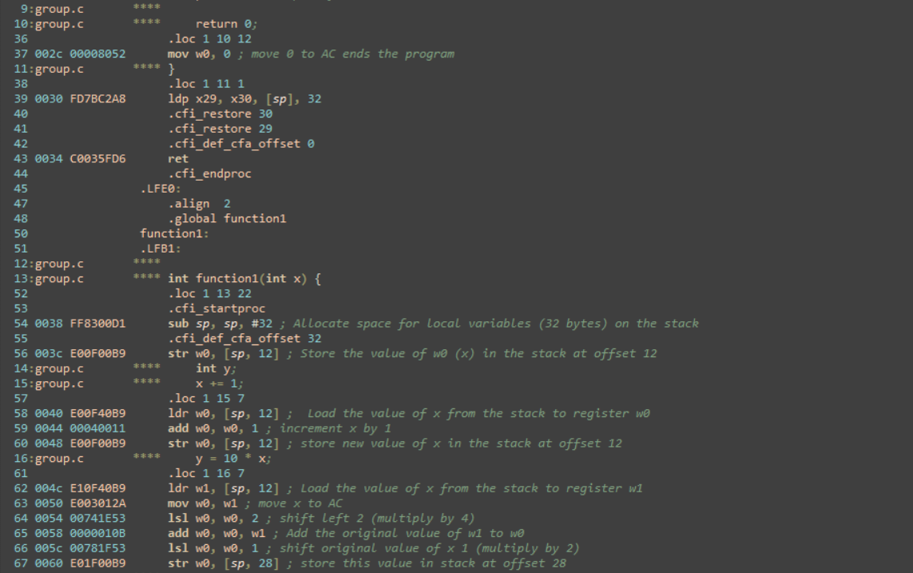
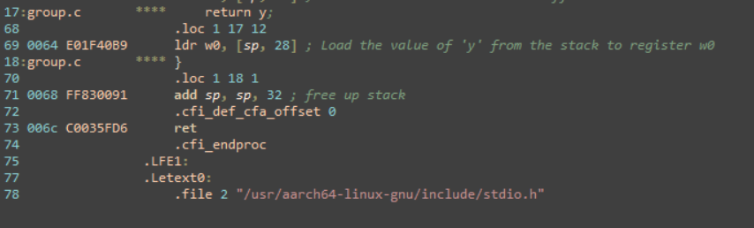

Slide 36
Unoptimized

Slide 37
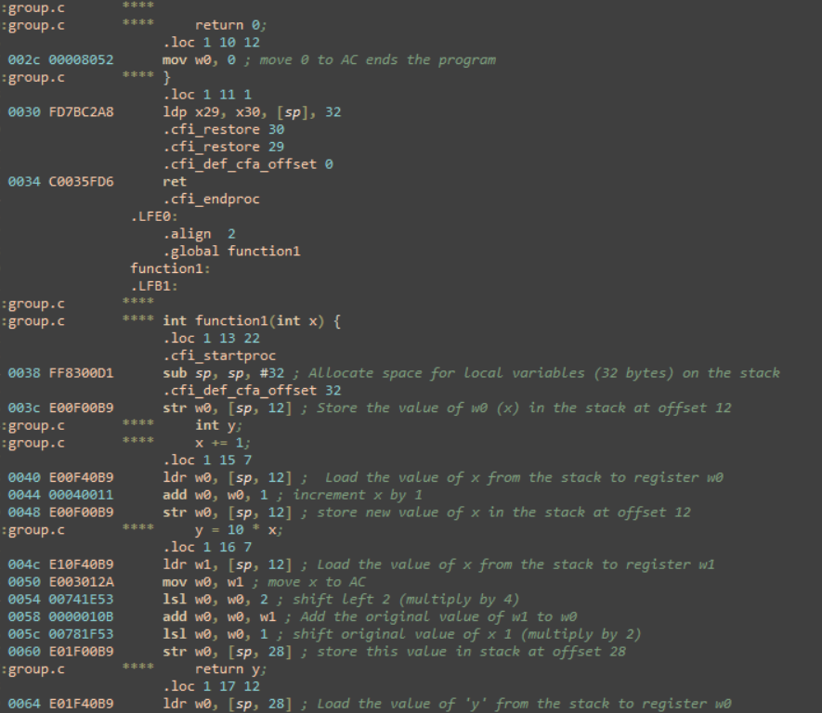
Unoptimized

